Slide 1
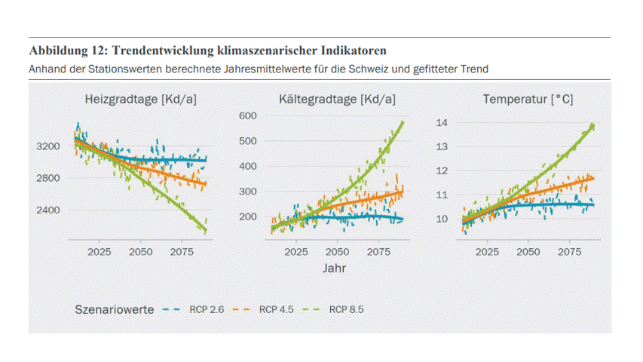
The problem: Energy scenarios are difficult to understand, difficult to access
EP2050+, SFOE
8 zip files
Number of files:
20 excel files with at least 20 tabs
10 pdfs:
Main file has 500 pages, 116 tables, 253 figures
Other files: 100-200 pages
Today: only experts (or not even) can interpret energy scenarios!!
Notes:
Dense PDFs, technical language, hidden in websites.

Slide 2
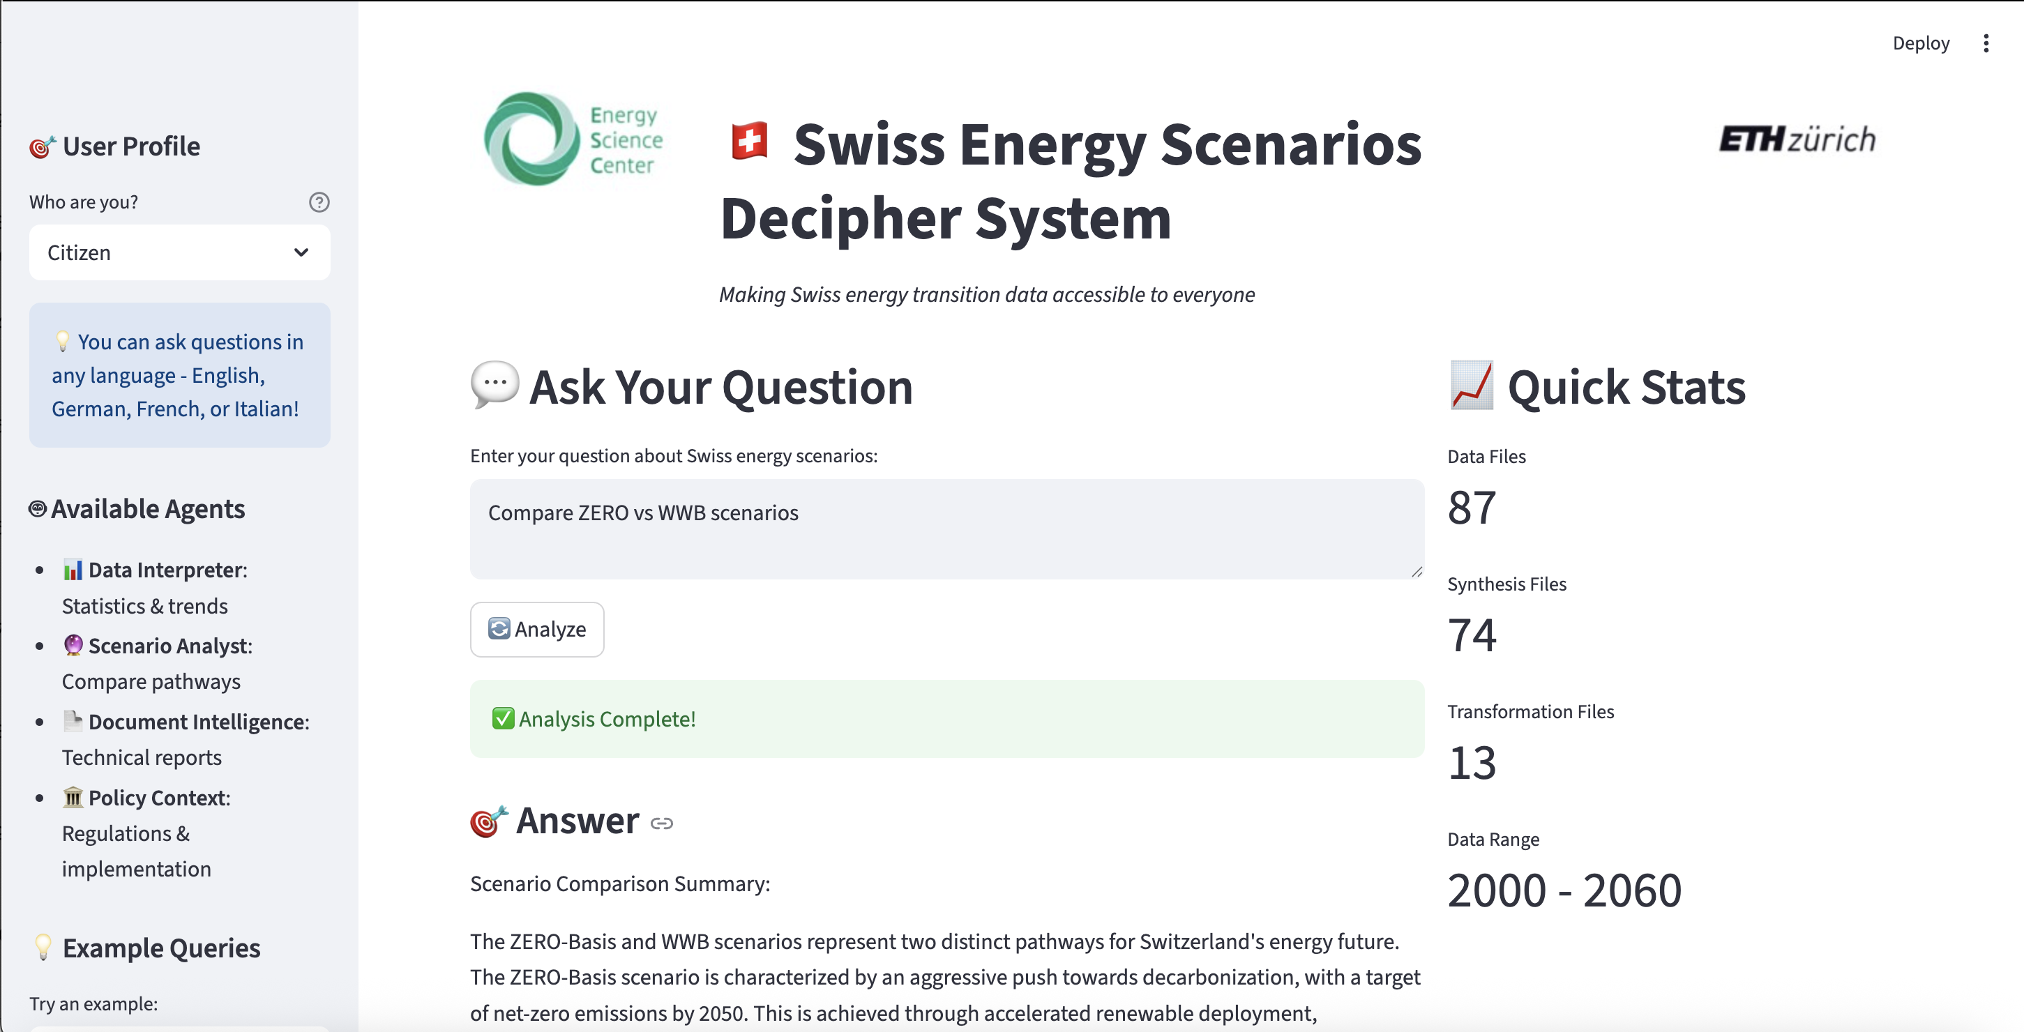
Our solution VoltVision: Chatbot for Energy Scenarios

Slide 3




Different users with different needs
Citizens
Enable everyday people to get informed and make decisions.
Journalists
People which need facts beside the explanation.
Educational
People wanting to learn about energy scenarios.
Policymakers People who need to deep dive with the topic.

Slide 4
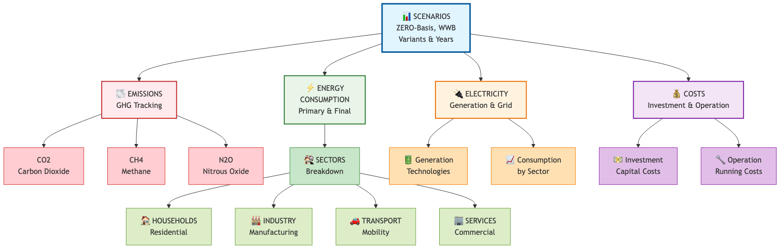
The complexity of scenarios

Slide 5
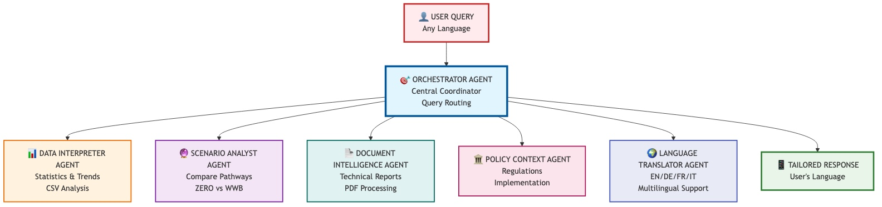
Agents

Slide 6
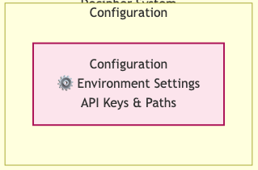
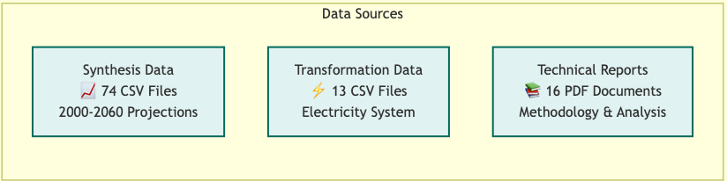
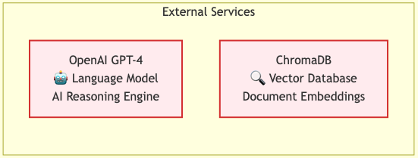
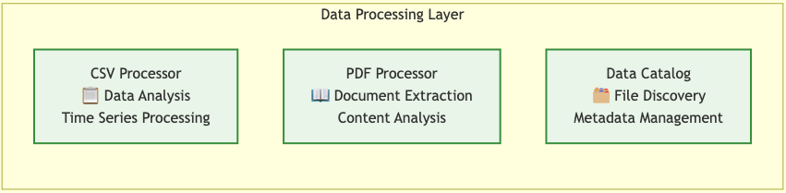
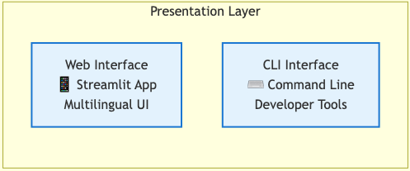
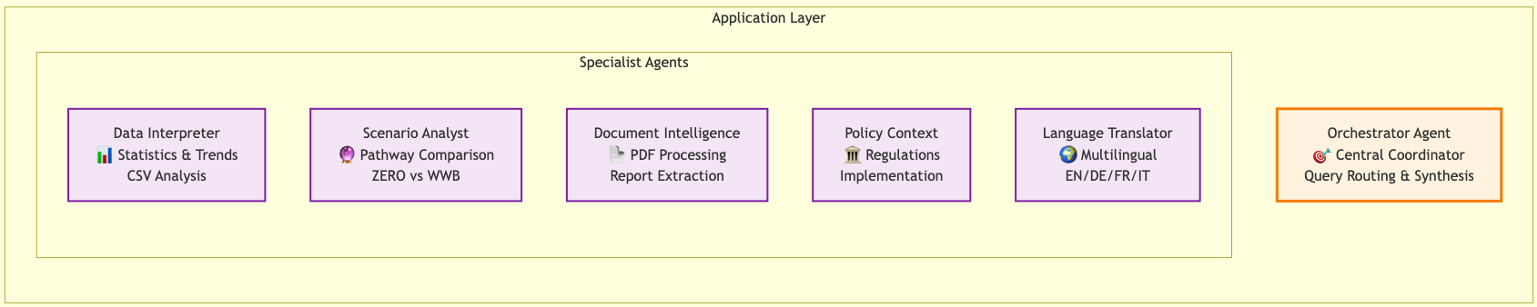
Component and Services

Slide 7
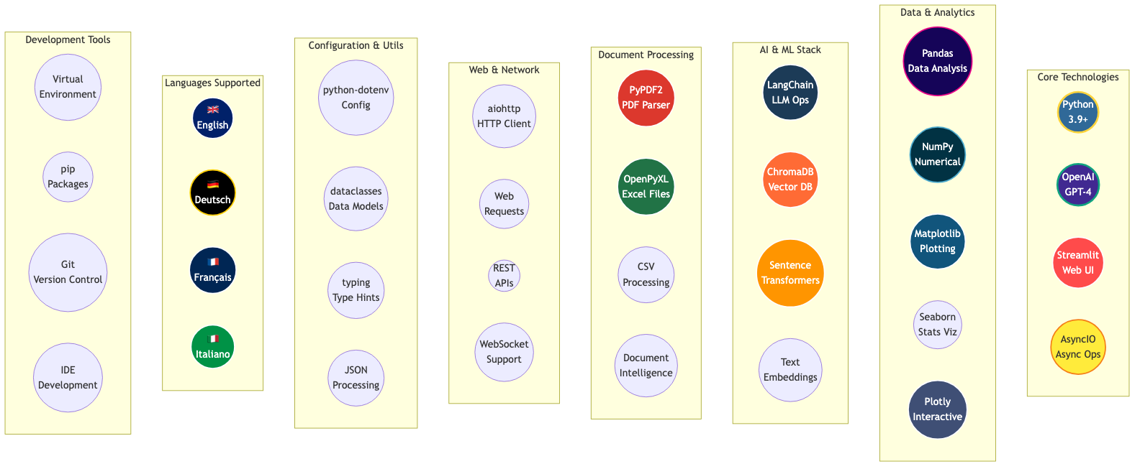
Tools

Slide 9
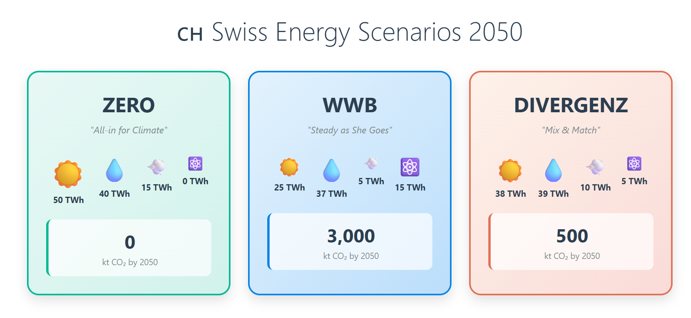
Notes:
Multi modal output – also graphical summaries are possible

Slide 10

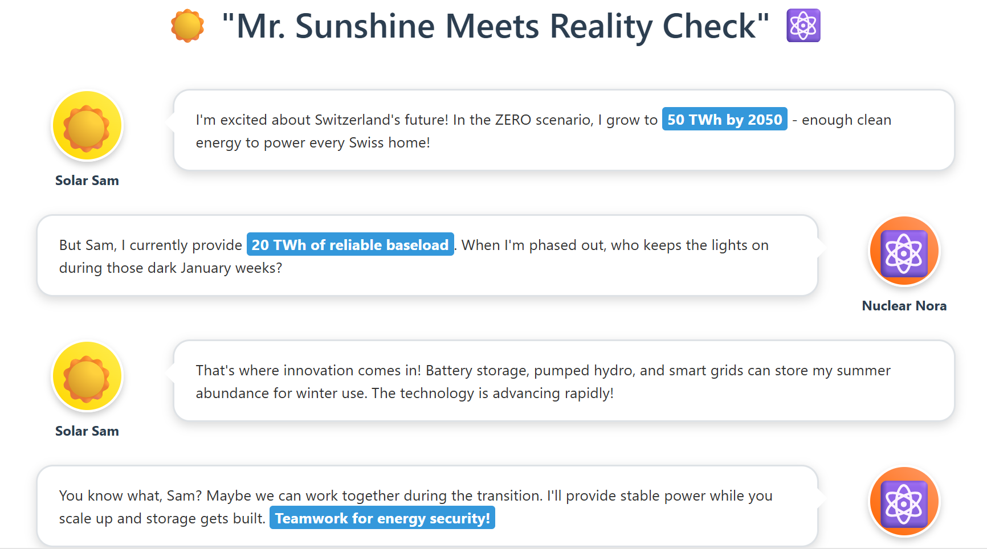
Notes:
Like this conversation between solar sam and nuclear nora

Slide 11
Future considerations
Just our documents Whole internet
Statistical Guardrails
Explicate rules for interpretation
Communicating uncertainty
Validation & Impact
Do people use it? Learn? Change?

Slide 12
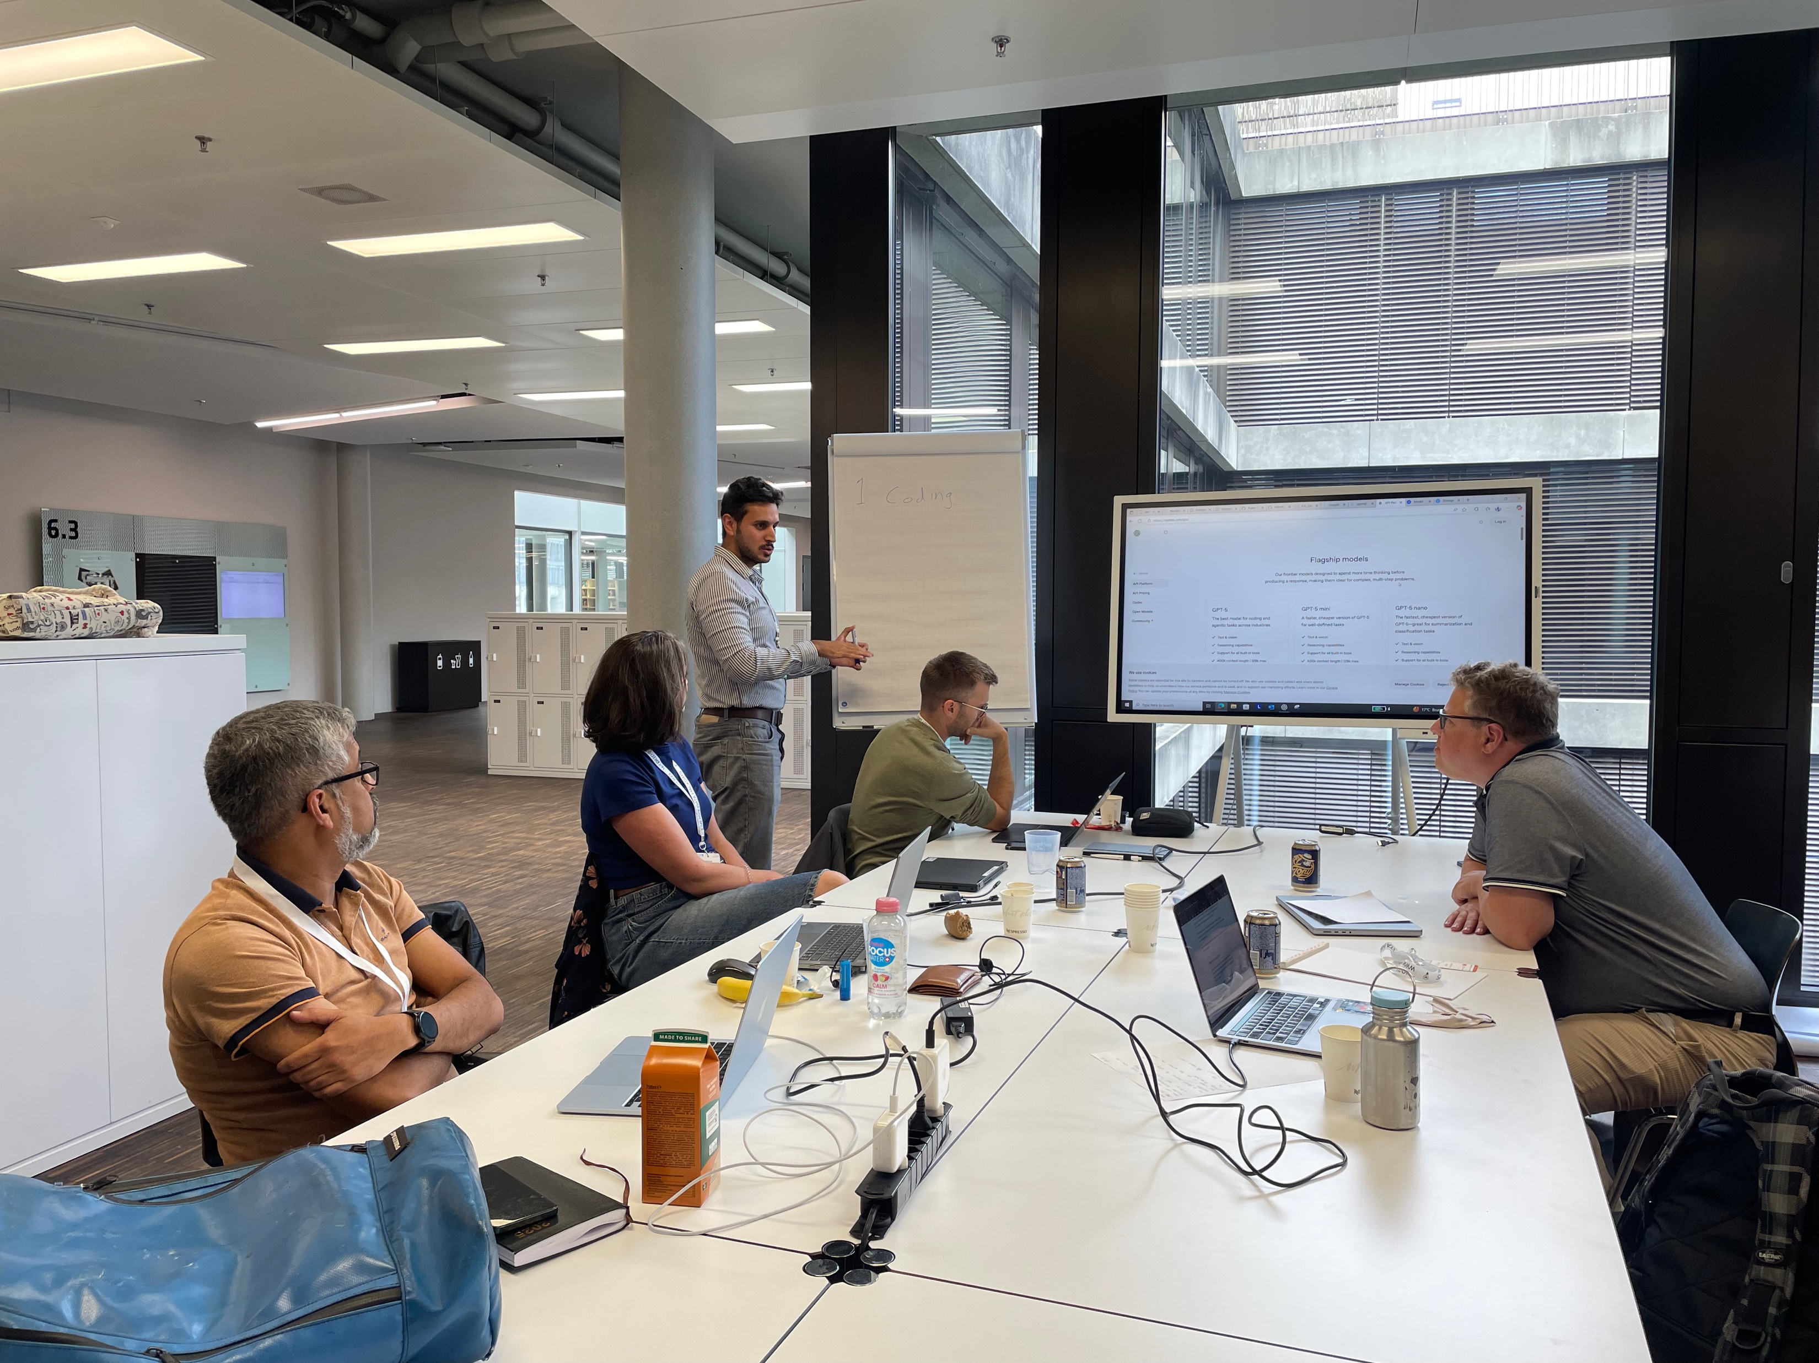
The VoltVision team
VoltVision: From Data Overwhelm to Democratic Dialogue
Mostafa Babaei
Sven
Rüegg
Branwen Owen
Jan Abrell
Hariprasad
Bantwal
Adriana
Marcucci

